Slide 1
Vector Mechanics For Engineers: Dynamics Twelfth Edition
Copyright © 2020 McGraw Hill , All Rights Reserved.
PROPRIETARY MATERIAL © 2020 The McGraw Hill Inc. All rights reserved. No part of this PowerPoint slide may be displayed, reproduced or distributed in any form or by any means, without the prior written permission of the publisher, or used beyond the limited distribution to teachers and educators permitted by McGraw Hill for their individual course preparation. If you are a student using this PowerPoint slide, you are using it without permission.

Slide 2
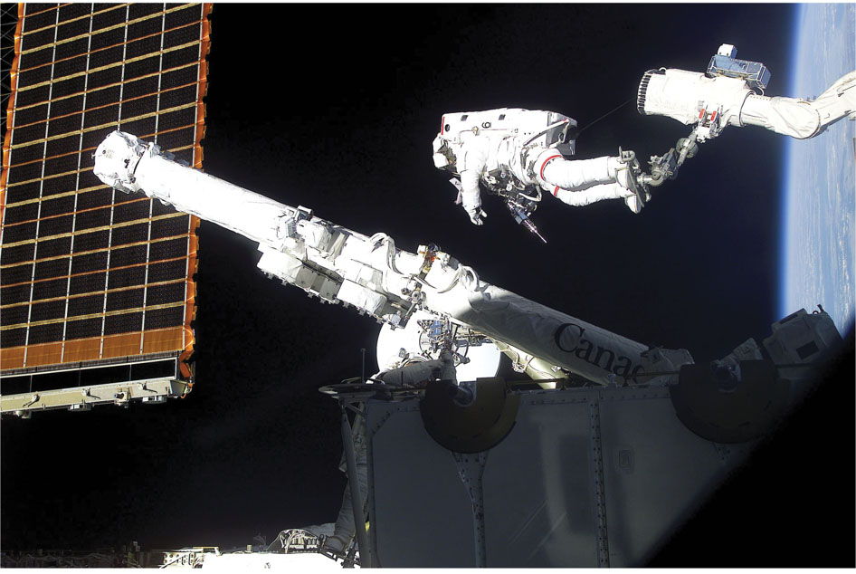
Chapter 18
Kinetics of Rigid Bodies in Three Dimensions

Slide 3
Contents
Introduction
Angular Momentum of a Rigid Body in Three Dimensions
Principle of Impulse and Momentum
Kinetic Energy
Sample Problem 18.1
Sample Problem 18.2
Motion of a Rigid Body in Three Dimensions
Euler’s Equations of Motion and D’Alembert’s Principle
Motion About a Fixed Point or a Fixed Axis
Sample Problem 18.3
Motion of a Gyroscope. Eulerian Angles
Steady Precession of a Gyroscope
Motion of an Axisymmetrical Body Under No Force

Slide 4
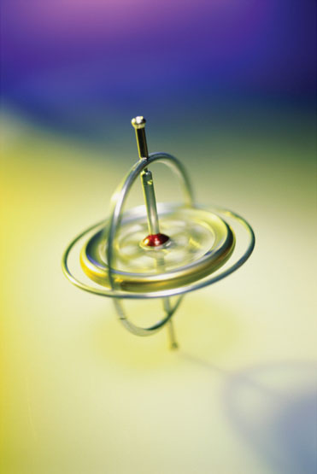
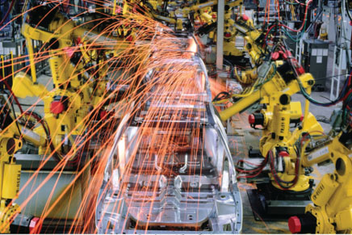
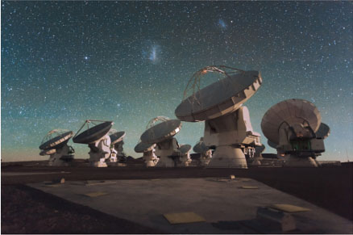
Three dimensional analyses are needed to determine the forces and moments on the gimbals of gyroscopes, the joints of robotic welders, and the supports of radio telescopes.
©Ingram Publishing RF, Agefotostock / Super Stock

Slide 5
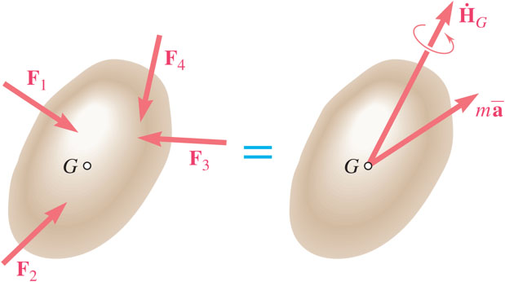
Introduction
The fundamental relations developed for the plane motion of rigid bodies may also be applied to the general motion of three dimensional bodies.
The relation
which was used to determine the angular momentum of a rigid slab is not valid for general three dimensional bodies and motion.
The current chapter is concerned with evaluation of the angular momentum and its rate of change for three dimensional motion and application to effective forces, the impulse-momentum and the work-energy principles.

Slide 6
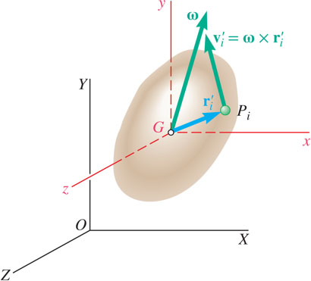
Angular Momentum of a Rigid Body in Three Dimensions 1
Angular momentum of a body about its mass center,
The x component of the angular momentum,

Slide 7
Angular Momentum of a Rigid Body in Three Dimensions 2
Transformation of
is characterized by the inertia tensor for the body,
With respect to the principal axes of inertia,
The angular momentum
of a rigid body and its angular velocity
have the same direction if, and only if,
is directed along a principal axis of inertia.

Slide 8
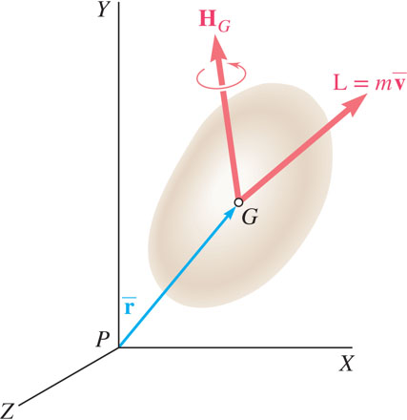
Rigid Body Angular Momentum in Three Dimensions 1
The momenta of the particles of a rigid body can be reduced to:
The angular momentum about any other given point O is

Slide 9
Rigid Body Angular Momentum in Three Dimensions 2
The angular momentum of a body constrained to rotate about a fixed point may be calculated from,
Or, the angular momentum may be computed directly from the moments and products of inertia with respect to the Oxyz frame.

Slide 10
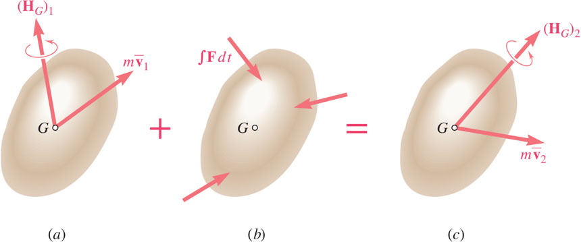
Principle of Impulse and Momentum
The principle of impulse and momentum can be applied directly to the three-dimensional motion of a rigid body,
Syst Momenta₁ + Syst Ext Imp₁₋₂ = Syst Momenta₂
The free-body diagram equation is used to develop component and moment equations.
For bodies rotating about a fixed point, eliminate the impulse of the reactions at O by writing equation for moments of momenta and impulses about O.

Slide 11
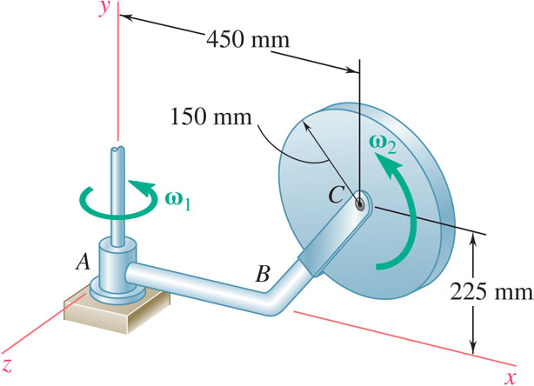
Concept Question 1
At the instant shown, the disk shown rotates with an angular velocity ω₂ with respect to arm ABC, which rotates around the y axis as shown (ω₁). Determine the directions of the angular momentum of the disc about point A (choose all that are correct).
+x
+y
+z
−x
−y
−z

Slide 12
Concept Question 2
At the instant shown, the disk shown rotates with an angular velocity ω₂ with respect to arm ABC, which rotates around the y axis as shown (ω₁). Determine the directions of the angular momentum of the disc about point A (choose all that are correct).
+x
+y
+z
−x
−y
−z

Slide 13
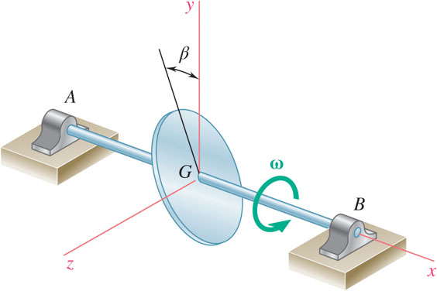
Concept Question 3
A homogeneous disk of mass m and radius r is mounted on the vertical shaft AB as shown Determine the directions of the angular momentum of the disc about the mass center G (choose all that are correct).
+x
+y
+z
−x
−y
−z

Slide 14
Concept Question 4
A homogeneous disk of mass m and radius r is mounted on the vertical shaft AB as shown Determine the directions of the angular momentum of the disc about the mass center G (choose all that are correct).
+x
+y
+z
−x
−y
−z

Slide 15
Kinetic Energy 1
Kinetic energy of particles forming rigid body,
If the axes correspond instantaneously with the principle axes,
With these results, the principles of work and energy and conservation of energy may be applied to the three-dimensional motion of a rigid body.

Slide 16
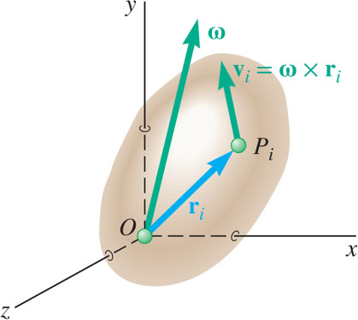
Kinetic Energy 2
Kinetic energy of a rigid body with a fixed point,
If the axes Oxyz correspond instantaneously with the principle axes

Slide 17
Concept Question 5
At the instant shown, the disk shown rotates with an angular velocity ω₂ with respect to arm ABC, which rotates around the y axis as shown (ω₁). What terms will contribute to the kinetic energy of the disk (choose all that are correct)?

Slide 18
Concept Question 6
At the instant shown, the disk shown rotates with an angular velocity ω₂ with respect to arm ABC, which rotates around the y axis as shown (ω₁). What terms will contribute to the kinetic energy of the disk (choose all that are correct)?

Slide 19
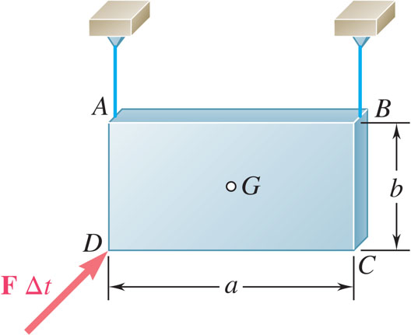
Sample Problem 18.1 1
Strategy:
Apply the principle of impulse and momentum. Since the initial momenta is zero, the system of impulses must be equivalent to the final system of momenta.
Assume that the supporting cables remain taut such that the vertical velocity and the rotation about an axis normal to the plate is zero.
Rectangular plate of mass m that is suspended from two wires is hit at D in a direction perpendicular to the plate.
Immediately after the impact, determine a) the velocity of the mass center G, and b) the angular velocity of the plate.
Principle of impulse and momentum yields to two equations for linear momentum and two equations for angular momentum.
Solve for the two horizontal components of the linear and angular velocity vectors.

Slide 20
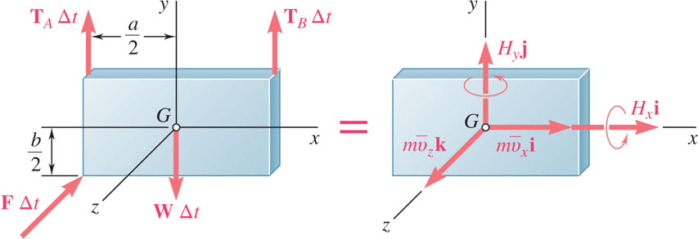
Sample Problem 18.1 2
Modeling and Analysis:
Apply the principle of impulse and momentum. Since the initial momenta is zero, the system of impulses must be equivalent to the final system of momenta.
Assume that the supporting cables remain taut such that the vertical velocity and the rotation about an axis normal to the plate is zero.
Since the x, y, and z axes are principal axes of inertia,

Slide 21
Sample Problem 18.1 3
Principle of impulse and momentum yields two equations for linear momentum and two equations for angular momentum.
Solve for the two horizontal components of the linear and angular velocity vectors.

Slide 22
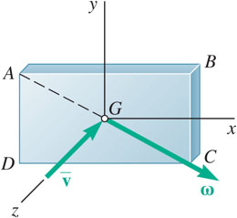
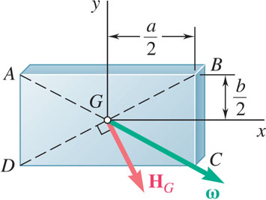
Sample Problem 18.1 4
Reflect and Think:
Equating the y components of the impulses and momenta and their moments about the z axis, you can obtain two additional equations that yield T_{A} = T_{B} = ½W.
His verifies that the wires remain taut and that the initial assumption was correct. If the impulse were at G, this would reduce to a two-dimensional problem.

Slide 23
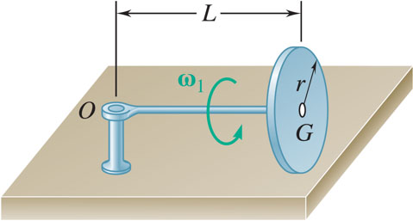
Sample Problem 18.2 1
Strategy:
The disk rotates about the vertical axis through O as well as about OG. Combine the rotation components for the angular velocity of the disk.
Compute the angular momentum of the disk using principle axes of inertia and noting that O is a fixed point.
A homogeneous disk of mass m is mounted on an axle OG of negligible mass. The disk rotates counter-clockwise at the rate ω₁ about OG.
Determine: a) the angular velocity of the disk, b) its angular momentum about O, c) its kinetic energy, and d) the vector and couple at G equivalent to the momenta of the particles of the disk.
The kinetic energy is computed from the angular velocity and moments of inertia.
The vector and couple at G are also computed from the angular velocity and moments of inertia.

Slide 24
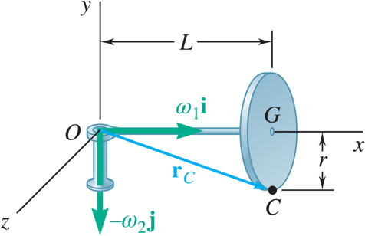
Sample Problem 18.2 2
Modeling and Analysis:
The disk rotates about the vertical axis through O as well as about OG. Combine the rotation components for the angular velocity of the disk,
Noting that the velocity at C is zero,

Slide 25
Sample Problem 18.2 3
Compute the angular momentum of the disk using principle axes of inertia and noting that O is a fixed point.
The kinetic energy is computed from the angular velocity and moments of inertia.

Slide 26
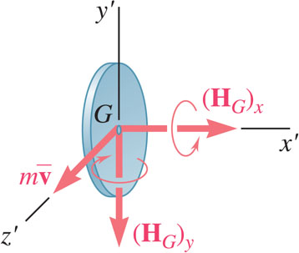
Sample Problem 18.2 4
The vector and couple at G are also computed from the angular velocity and moments of inertia.
Reflect and Think:
If the mass of the axle were not negligible and it was instead modeled as a slender rod with a mass M_{axle}, it would also contribute to the kinetic energy,

Slide 27
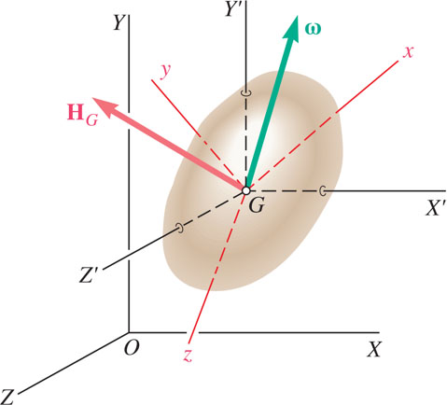
Motion of a Rigid Body in Three Dimensions
Angular momentum and its rate of change are taken with respect to centroidal axes
of fixed orientation.
Transformation of
is independent of the system of coordinate axes.
Convenient to use body fixed axes Gxyz where moments and products of inertia are not time dependent.
Define rate of change of change of
with respect to the rotating frame,

Slide 28
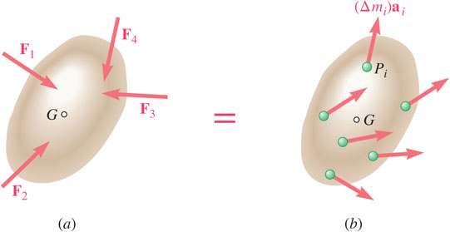
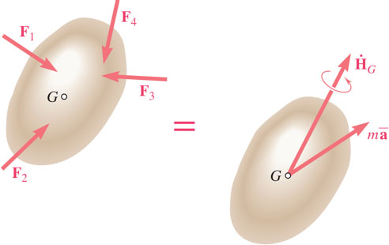
Euler’s Equations of Motion & D’Alembert’s Principle
and Gxyz chosen to correspond to the principal axes of inertia,
With
Euler’s Equations:
System of external forces and effective forces are equivalent for general three dimensional motion.
System of external forces are equivalent to the vector and couple,

Slide 29
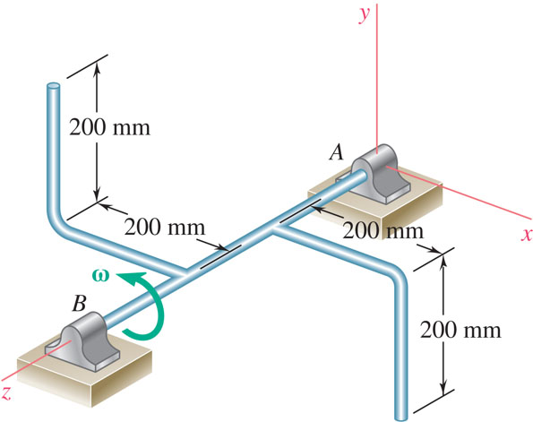
Group Problem Solving 1
Strategy:
The part rotates about the axis AB. Determine the mass moment of inertia matrix for the part.
Compute the angular momentum of the disk using the moments inertia.
Two L-shaped arms, each weighing 5 kg, are welded at the third points of the 600 mm shaft AB. Knowing that shaft AB rotates at the constant rate ω = 360 rpm, determine the angular momentum of the body about A and the angle it forms with AB.

Slide 30
Group Problem Solving 2
Modeling and Analysis:
Given: m = 5kg, a = 200mm = 0.2 m
Find: H_{A}
There is only rotation about the z-axis, what relationship(s) can you use?
Split the part into four different segments, then determine I_{xz}, I_{yz}, and I_{z}. What is the mass of each segment?
Mass of each of the four segments

Slide 31
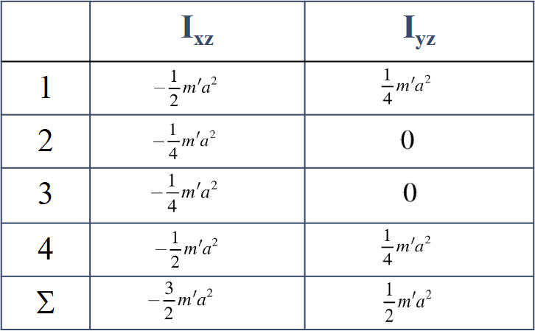
Group Problem Solving 3
Fill in the table below to help you determine I_{xz} and I_{yz}.
Determine I_{z} by using the parallel axis theorem – do parts 1 and 4 first
Parts 2 and 3 are also equal to one another

Slide 32
Group Problem Solving 4
Calculate H_{x}
Calculate H_{y}
Calculate H_{z}
Total Vector

Slide 33
Group Problem Solving 5
Angle Between AB and H_{A}:

Slide 34
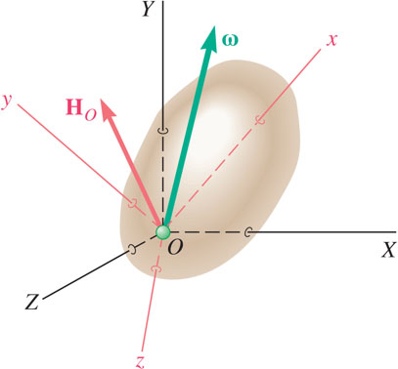
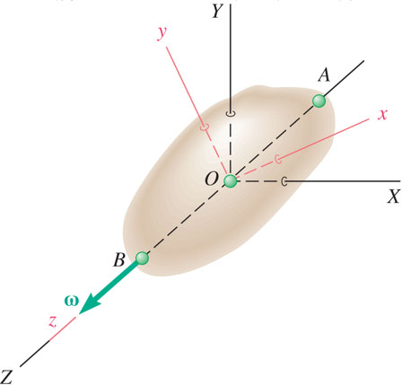
Motion About a Fixed Point or a Fixed Axis
For a rigid body rotation around a fixed point,
For a rigid body rotation around a fixed axis,

Slide 35
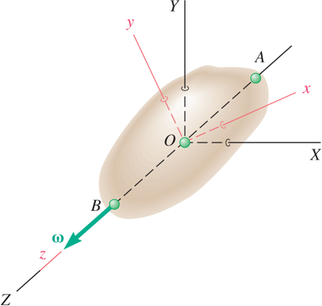
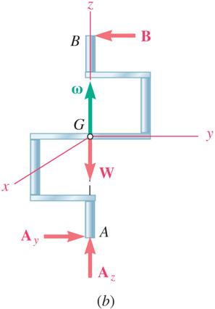
Rotation About a Fixed Axis
For a rigid body rotation around a fixed axis,
If symmetrical with respect to the xy plane,
If not symmetrical, the sum of external moments will not be zero, even if α = 0,
A rotating shaft requires both static
balancing to avoid excessive vibration and bearing reactions.
and dynamic

Slide 36
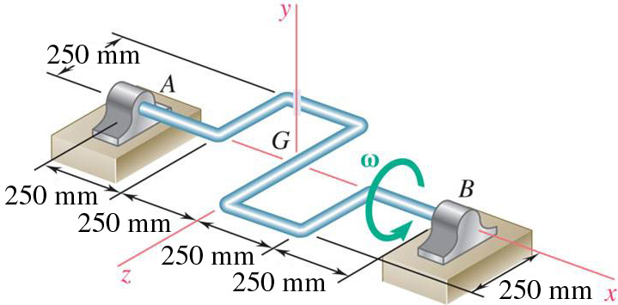
Concept Question 7
The device at the right rotates about the x axis with a non-constant angular velocity. Which of the following is true (choose one)?
a) You can use Euler’s equations for the provided x, y, z axes
b) The only non-zero moment will be about the x axis
c) At the instant shown, there will be a non-zero y-axis bearing force
d) The mass moment of inertia I_{xx} is zero

Slide 37
Concept Question 8
The device at the right rotates about the x axis with a non-constant angular velocity. Which of the following is true (choose one)?
a) You can use Euler’s equations for the provided x, y, z axes
b) The only non-zero moment will be about the x axis
c) Answer: At the instant shown, there will be a non-zero y-axis bearing force
d) The mass moment of inertia I_{xx} is zero

Slide 38
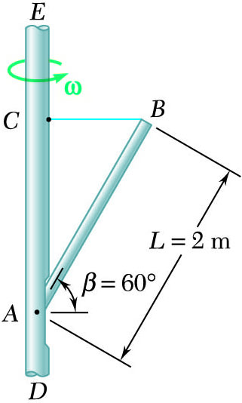
Sample Problem 18.3 1
Strategy:
Evaluate the system of effective forces by reducing them to a vector attached at G and couple
Expressing that the system of external forces is equivalent to the system of effective forces, write vector expressions for the sum of moments about A and the summation of forces.
Rod AB with mass m = 20 kg is pinned at A to a vertical axle which rotates with constant angular velocity ω = 15 rad/s. The rod position is maintained by a horizontal wire BC.
Determine the tension in the wire and the reaction at A.
Solve for the wire tension and the reactions at A.

Slide 39
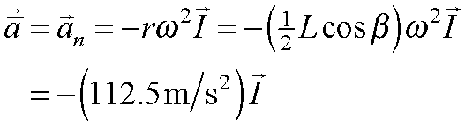
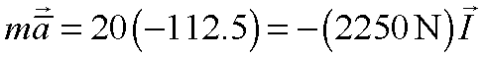
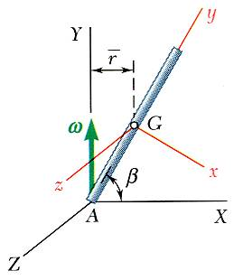
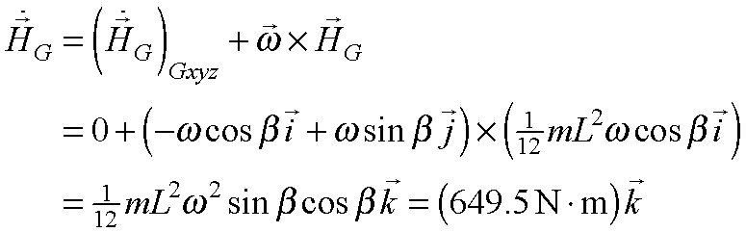
Sample Problem 18.3 2
Modeling and Analysis:
Evaluate the system of effective forces by reducing them to a vector attached at G and couple

Slide 40
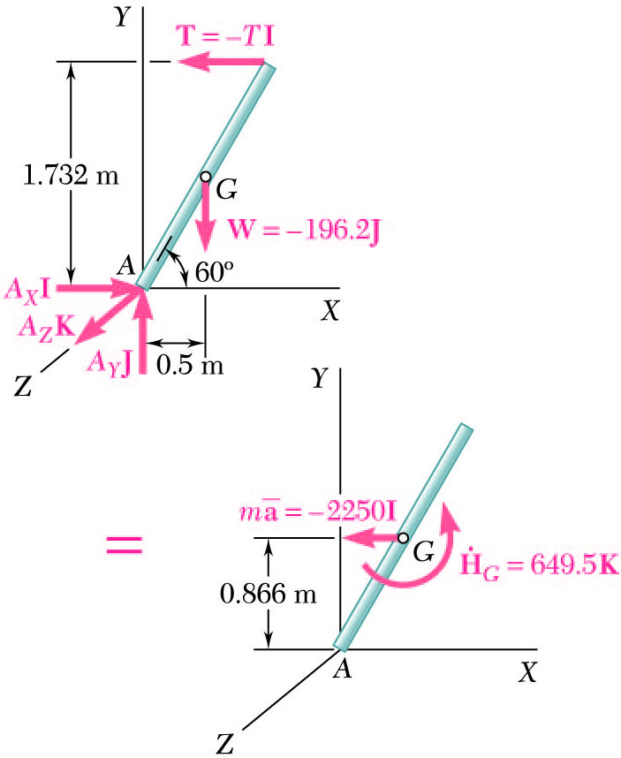
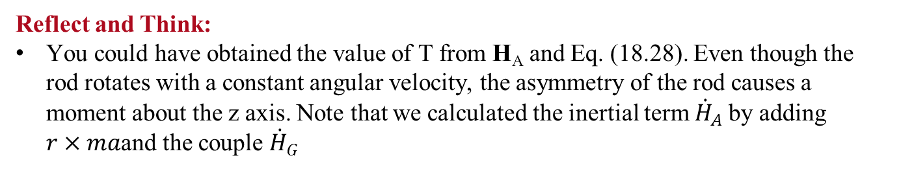
Sample Problem 18.3 3
Expressing that the system of external forces is equivalent to the system of effective forces, write vector expressions for the sum of moments about A and the summation of forces.
Reflect and Think:
You could have obtained the value of T from H_{A} and Eq. (18.28). Even though the rod rotates with a constant angular velocity, the asymmetry of the rod causes a moment about the z axis. Note that we calculated the inertial term ${\dot{H}}_{A}$by adding $r×ma$and the couple ${\dot{H}}_{G}$

Slide 41
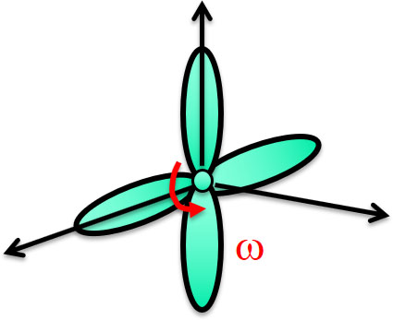
Group Problem Solving 6
Strategy:
Determine the overall angular velocity of the aircraft propeller.
Determine the mass moment of inertia for the propeller.
A four-bladed airplane propeller has a mass of 160 kg and a radius of gyration of 800 mm. Knowing that the propeller rotates at 1600 rpm as the airplane is traveling in a circular path of 600-m radius at 540 km/h, determine the magnitude of the couple exerted by the propeller on its shaft due to the rotation of the airplane.
Calculate the angular momentum of the propeller about its CG.
Calculate the time rate of change of the angular momentum of the propeller about its CG.
Calculate the moment that must be applied to the propeller and the resulting moment that is applied on the shaft.

Slide 42
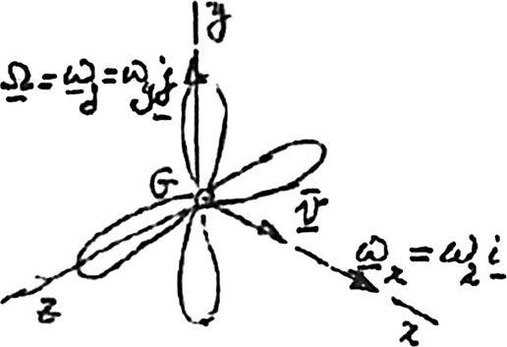
Group Problem Solving 7
Modeling and Analysis:
Establish axes for the rotations of the aircraft propeller
Determine the x-component of its angular velocity
Determine the y-component of its angular velocity
Determine the mass moment of inertia

Slide 43

Group Problem Solving 8
Angular momentum about G equation:
Time rate of change of angular momentum about G :
Determine the moment that must be applied to the propeller shaft
Determine the moment that must be applied to the propeller shaft

Slide 44
Concept Question 9
The airplane propeller has a constant angular velocity +ω_{x}. The plane begins to pitch up at a constant angular velocity.
The propeller has zero angular acceleration.
TRUE
FALSE
Which direction will the pilot have to steer to counteract the moment applied to the propeller shaft?
a) +x
b) +y
c) +z
d) −y
e) −z

Slide 45
Concept Question 10
The airplane propeller has a constant angular velocity + ω_{x}. The plane begins to pitch up at a constant angular velocity.
The propeller has zero angular acceleration.
TRUE
Answer: FALSE
Which direction will the pilot have to steer to counteract the moment applied to the propeller shaft?
a) +x
b) Answer: +y
c) +z
d) −y
e) −z

Slide 46
Gyroscopes are used in the navigation system of the Hubble telescope, and can also be used as sensors (such as in the Segway PT). Modern gyroscopes can also be MEMS (Micro Electro-Mechanical System) devices, or based on fiber optic technology.

Slide 47
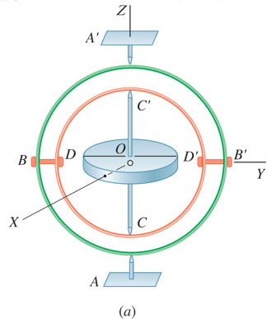
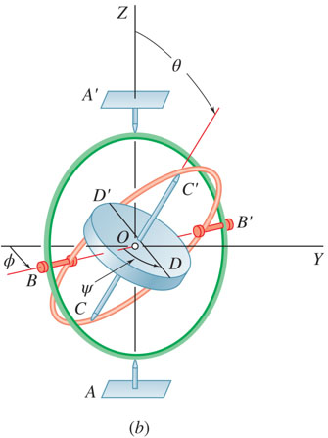
Motion of a Gyroscope. Eulerian Angles 1
A gyroscope consists of a rotor with its mass center fixed in space but which can spin freely about its geometric axis and assume any orientation.
From a reference position with gimbals and a reference diameter of the rotor aligned, the gyroscope may be brought to any orientation through a succession of three steps:
a) rotation of outer gimbal through ϕ about AA′,
b) rotation of inner gimbal through θ about BB′
c) rotation of the rotor through ψ about CC’.
ϕ, θ, and ψ are called the Eulerian Angles and,

Slide 48
Motion of a Gyroscope. Eulerian Angles 2
The angular velocity of the gyroscope,
Equation of motion,

Slide 49
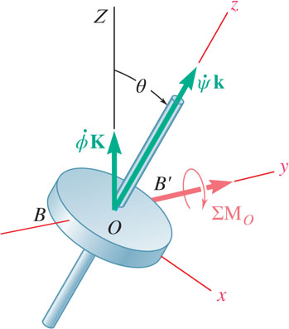
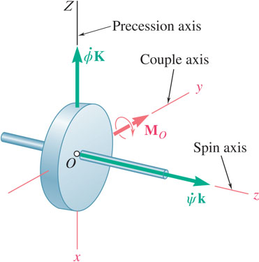
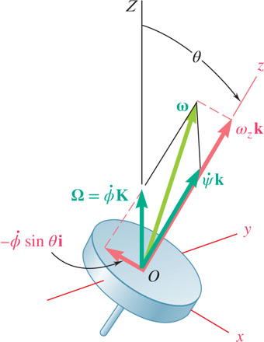
Steady Precession of a Gyroscope
When the precession and spin axis are at a right angle,
Steady precession,
Couple is applied about an axis perpendicular to the precession and spin axes
Gyroscope will precess about an axis perpendicular to both the spin axis and couple axis.

Slide 50
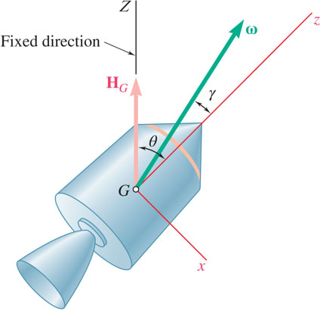
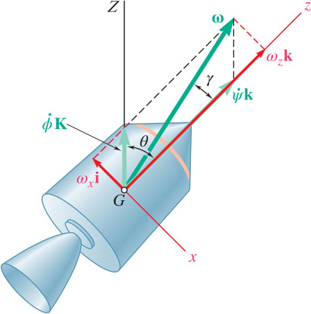
Motion of an Axisymmetrical Body Under No Force 1
Consider motion about its mass center of an axisymmetrical body under no force but its own weight, example: projectiles, satellites, and space craft.
and z in a rotating axes system along the axis of symmetry. The x axis is chosen to lie in the Zz plane.
Define the Z axis to be aligned with
θ = constant and body is in steady precession.
Note:

Slide 51
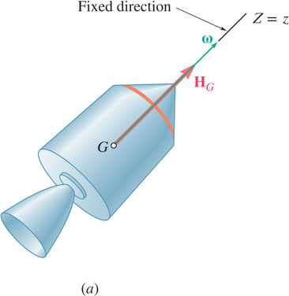
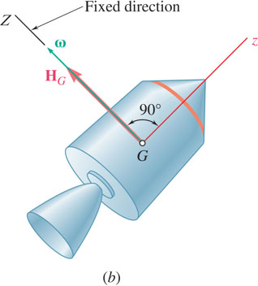
Motion of an Axisymmetrical Body Under No Force 2
Two cases of motion of an axisymmetrical body which under no force which involve no precession:
Body set to spin about its axis of symmetry,
and body keeps spinning about its axis of symmetry.
Body is set to spin about its transverse axis,
and body keeps spinning about the given transverse axis.

Slide 52
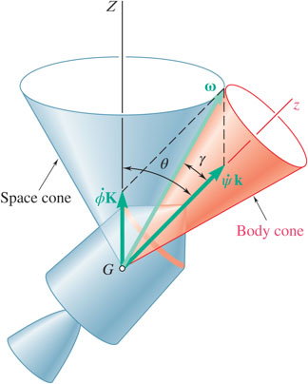
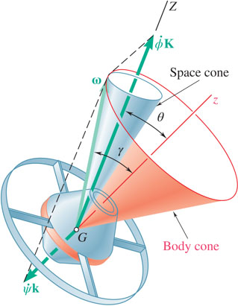
Motion of an Axisymmetrical Body Under No Force 3
The motion of a body about a fixed point (or its mass center) can be represented by the motion of a body cone rolling on a space cone. In the case of steady precession the two cones are circular.
I < I′. Case of an elongated body. γ < θ and the vector ω lies inside the angle ZGz. The space cone and body cone are tangent externally; the spin and precession are both counterclockwise from the positive z axis. The precession is said to be direct.
I > I′. Case of a flattened body. γ > θ and the vector ω lies outside the angle ZGz. The space cone is inside the body cone; the spin and precession have opposite senses. The precession is said to be retrograde.

Slide 53
End of Chapter 18

